Slide 1
Case Study 3:
Textual Analysis of Movie Reviews
Abigail Albuquerque, Aria Yan, Isabel Herrero Estrada, Sandra Phan, Megan Sin

Slide 2
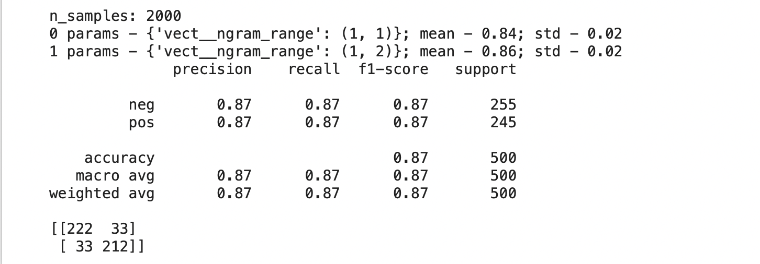
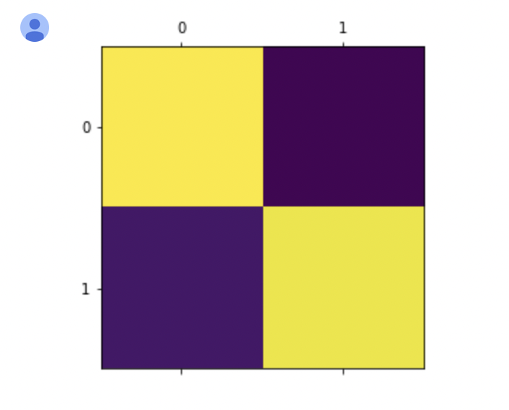
Problem 1: Sentiment Analysis on Movie Reviews
The number of samples, mean and standard deviation for candidate followed by parameter settings, predicted outcome on tester, classification report and confusion matrix.
Confusion matrix plot

Slide 3
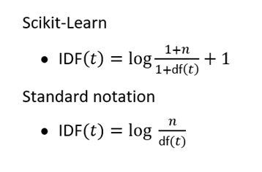
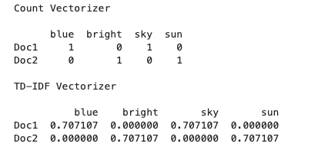
Problem 2: Exploring TF-IDF class
What is TF-IDF?
TF-IDF stands for Term Frequency - Inverse Document Frequency. It is a statistic that reflects how important a word is to a group of documents.
Example:

Slide 4
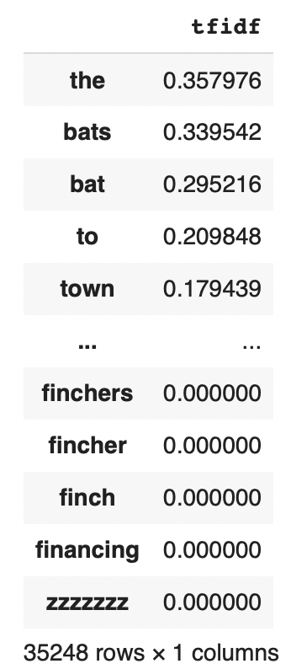
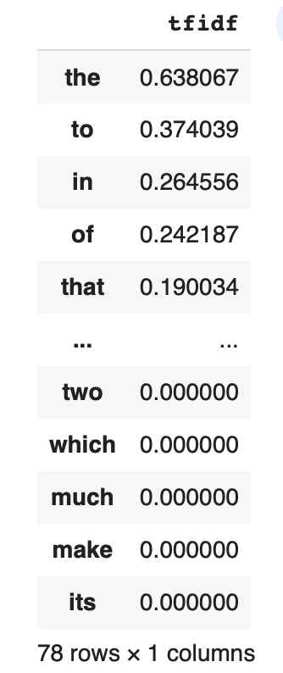
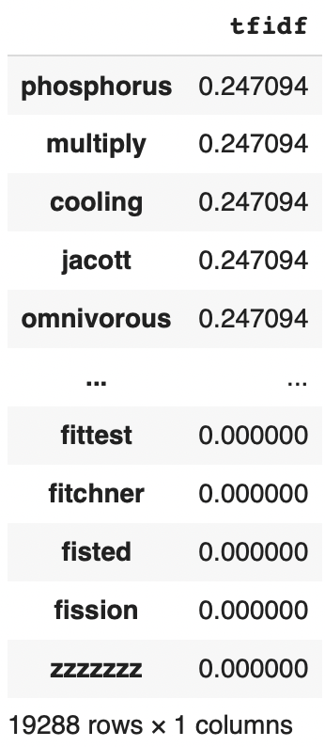
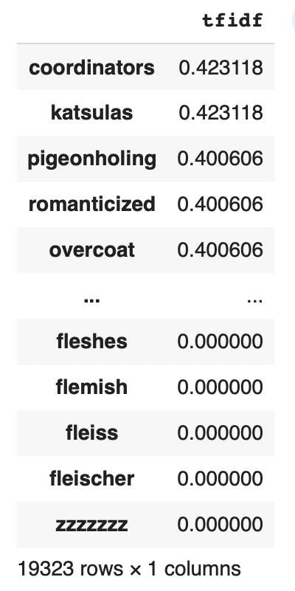
Exploring min_df, max_df and n_gram parameters of tfidVectorizer
No parameters
min_df = 0.5
max_df = 2
ngram_range = (1,2)

Slide 5
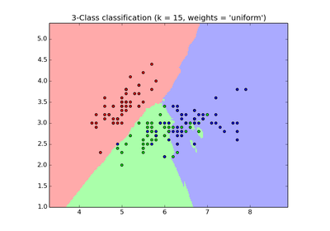
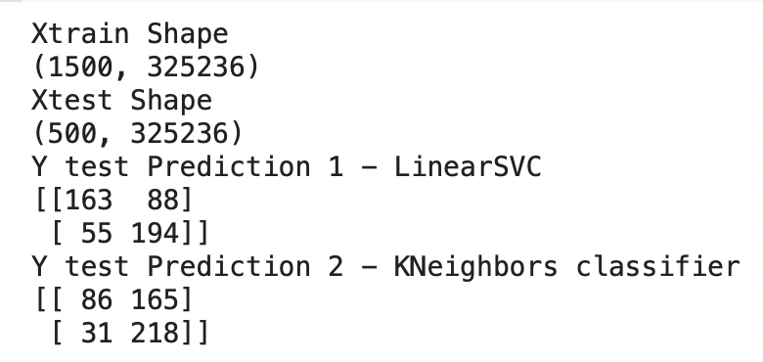
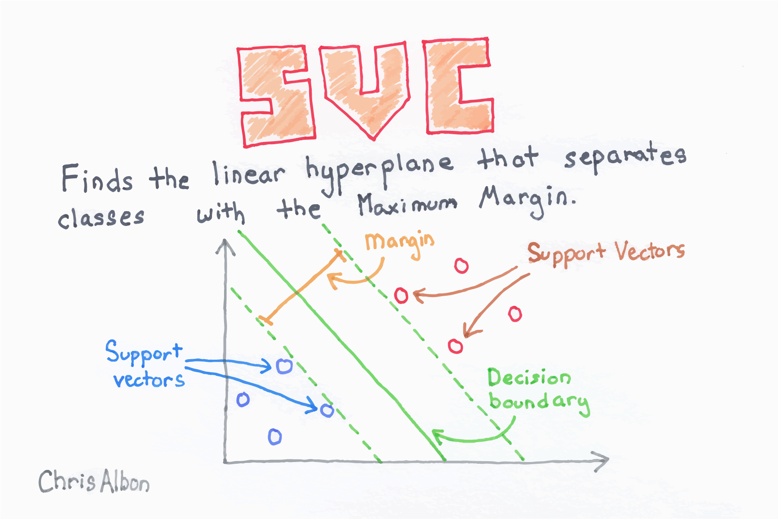
Problem 3: Machine Learning Algorithms
Parameters we picked - max_df = 1 and ngram_range = (1,2)
Computed Xtrain and Xtest
Examined 2 classifiers LinearSVC and KNeighbors

Slide 6
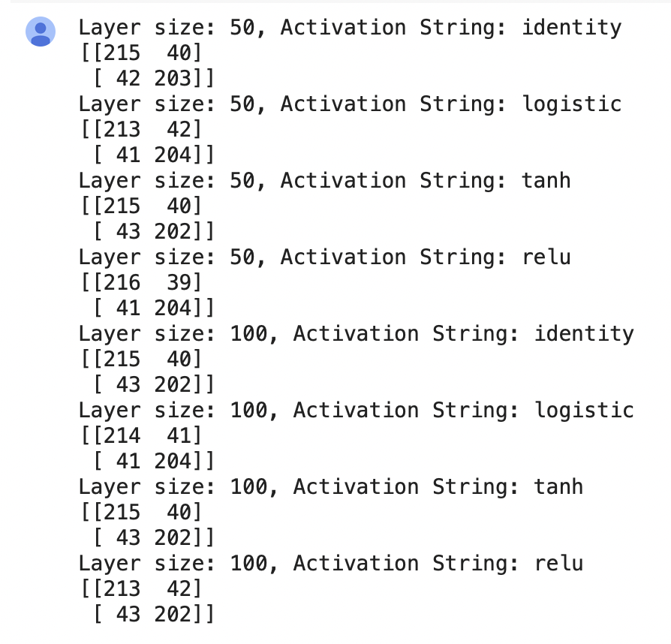
Problem 4: Using MLP to classify reviews and comparing accuracies against baseline algorithms.
Layer sizes - 50*, 100
Activation Strings - identity, logistic, relu*, tanh
*Most accurate

Slide 7
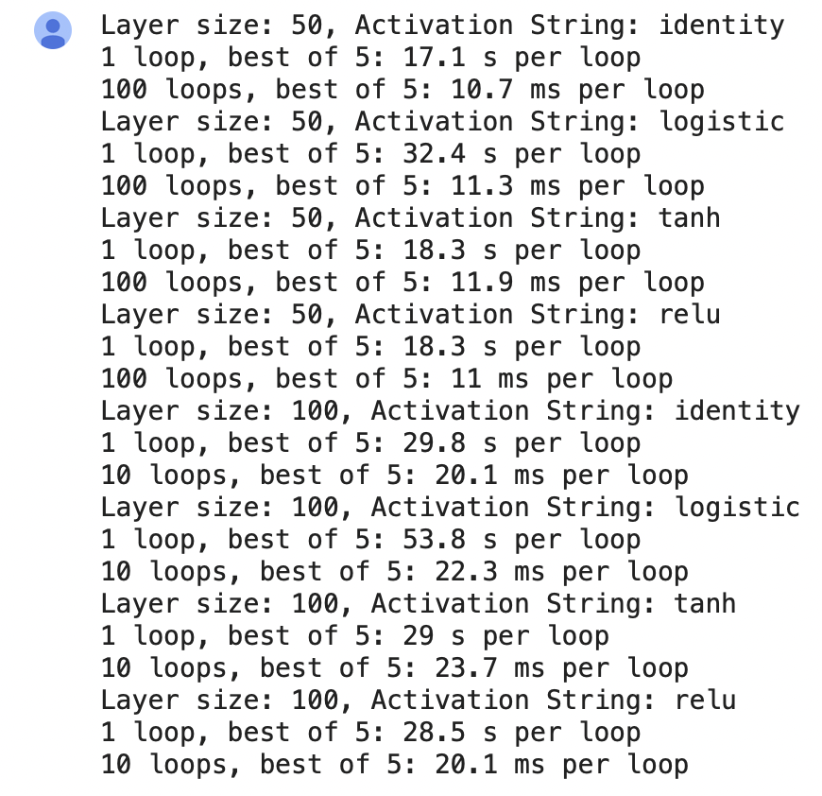
Problem 5: How fast are the algorithms?
Layer sizes - 50, 100*
Activation Strings - identity, logistic*, relu, tanh
Runtimes for fit function vs predict function:
Fit consistently takes longer to run than predict. Fit uses training set, predict uses test set. Training set is much larger than test set.
*Longer runtimes

Slide 8

Problem 6: Business Question
Business product: Monitor feelings on social media for companies to gage customer opinions/reviews

Slide 9


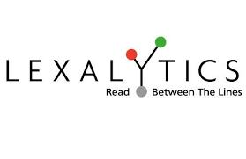

Our competitors - companies specialising in sentiment analysis like MonkeyLearn, IBM Watson, Lexalytics and Amazon Comprehend
Amazon Comprehend

Slide 10
Thanks for listening!

